Slide 1
Distributed System (BESE-VII) POKHARA UNIVERSITY
Compiled by
Er. Madan Kadariya
Assistant Professor
HOD, Department of Information Technology Engineering
Nepal College of Information Technology
Balkumari, Lalitpur

Slide 2
Chapter 4: Agreement in Distributed System
References:
G. Coulouris, J. Dollimore and T. Kindberg; Distributed Systems Concepts and Design,4th Edition.
Andrew S. Tanenbaum and Maarten van Steen; Distributed Systems: Principles and Paradigms, 2nd Edition.

Slide 3
Outline
4.1. Distributed Election
4.1.1. The Bully Algorithm
4.1.2. A Ring algorithm
4.2. Algorithms for Mutual Exclusion
4.2.1. Central coordinator Algorithm
4.2.2. Token and non-token based Ricart & Agrawala algorithm
4.2.3. Token Ring Algorithm

Slide 4
Mutual Exclusion in DS

Slide 5
Mutual exclusion in DS
There are three major communication scenarios:
One-way Communication usually do not need mutual exclusion.
Client/server communication is for multiple clients making service request to a shared server. If co-ordination is required among the clients, it is handled by the server and there is no explicit interaction among client process – and hence no need of mutual exclusion
Inter process communication: processes need to exchange information to reach some conclusion about the system or some agreement among the cooperating processes.

Slide 6
Background of Mutual Exclusion
Inter Process Communication (IPC)
Need to Access a Shared Resource (Memory)
Critical Section (Region)
A critical section is a section code or region in which a process(or thread) competes in a potentially destructive way with another process(thread) for access to a shared data item or file
Race Condition
a problem caused because of accessing the Critical Section by two or more processes at the same time.
Mutual Exclusion
a solution to the Race Condition

Slide 7
Definition of Mutual Exclusion
If two processes are allowed to concurrently be in competing critical sections, then incorrect results may be computed – called a Race Condition
The process of ensuring that this destructive interaction does no occur is called mutual exclusion (mutex).
In other words, mutual exclusion is the process of making only one process to enter into the critical section at the same time.

Slide 8
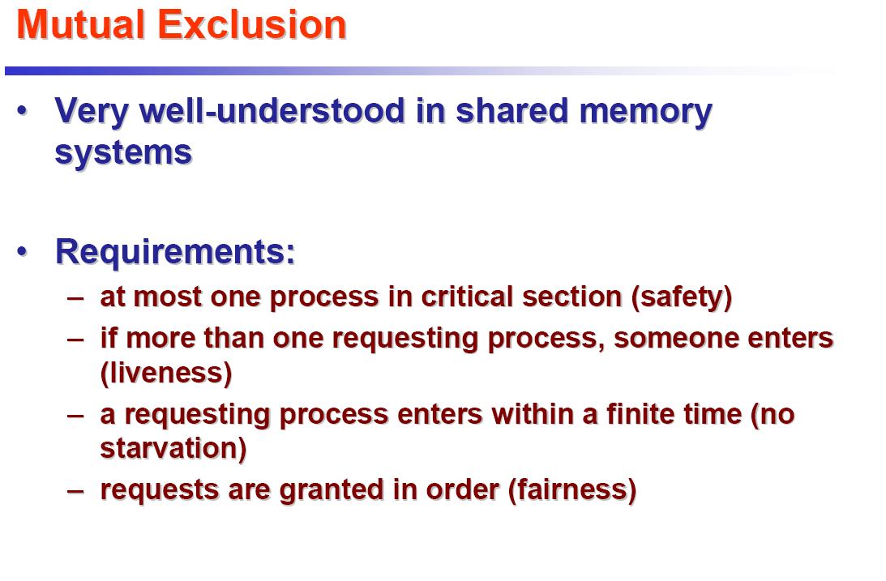

Slide 9
Mutual Exclusion Algorithms
There are two basic approaches to distributed mutual exclusion:
Non-token-based (permission based):
each process freely and equally competes for the right to use the shared resource; requests are arbitrated by a central control site or by distributed agreement.
Token-based:
a logical token representing the access right to the shared resource is passed in a regulated fashion among the processes; whoever holds the token is allowed to enter the critical section.

Slide 10
Mutual Exclusion Algorithms
Non-token based (permission based) Algorithms:
Permission from a central Coordinator
Central Coordinator Based Algorithm
Permission from all (distributed) processes
Lamport Algorithm
Ricart Agarwala Algorithm
Token Based Algorithm
Token Ring Algorithm
Suzuki Kasami Algorithm
Raymond Algorithm
Singhal Algorithm etc.

Slide 11
Central Coordinator Based Algorithm
A central coordinator grants permission to enter a CS
In this algorithm, a process that wants to enter into a CS has to take a permission from a central coordinator
The scheme is simple and easy to implement.
The strategy requires only three messages per use of a CS (request, OK, release).

Slide 12
Algorithm:
To enter a CS, a process sends a request message to the coordinator and then waits for a reply (during this waiting period the process can continue with other work).
The reply from the coordinator gives the right to enter the CS.
After finishing work in the CS the process notifies the coordinator with a release message.

Slide 13
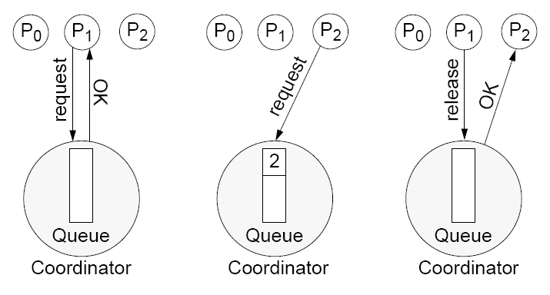
Example:

Slide 14
Central Coordinator Based Algorithm: Pseudo code
Coordinator loop receive(msg); case msg of REQUEST: if nobody in CS then reply GRANTED else queue the REQ; reply DENIED RELEASE: if queue not empty then remove 1st on the queue reply GRANTED //modified algo end case end loop
Client send(REQUEST); receive(msg); while msg != GRANTED then receive(msg); enter CS;
send(RELEASE)

Slide 15
Central Coordinator Based Algorithm
Advantages
guarantees mutual exclusion
It is fair (First Come First Served)
Easy to implement
Disadvantages
The coordinator can become a performance bottleneck.
The coordinator is a critical point of failure:
If the coordinator crashes, a new coordinator must be created. The coordinator can be one of the processes competing for access; an election algorithm has to be run in order to choose one and only one new coordinator.
if no explicit DENIED message, then cannot distinguish permission denied from a dead coordinator

Slide 16
Mutual Exclusion Algorithms
Non-token based (permission based) Algorithms:
Permission from a central Coordinator
Central Coordinator Based Algorithm
Permission from all (distributed) processes
Lamport Algorithm
Ricart Agarwala Algorithm
Token Based Algorithm
Token Ring Algorithm
Suzuki Kasami Algorithm
Raymond Algorithm
Singhal Algorithm etc.

Slide 17
Permission from all (distributed) processes
In a distributed environment it seems more natural to implement mutual exclusion, based upon distributed agreement - not on a central coordinator. The basic algorithm goes like this:
Two processes want to enter the same critical region at the same moment.
Both send request messages to all processes
All events are time-stamped by the global ordering algorithm
The process whose request event has smaller time-stamp wins
Every process must respond to request messages

Slide 18
Permission from all (distributed) processes – Distributed Algorithm
Lamport’s Algorithm
Ricart Agarwala Algorithm

Slide 19
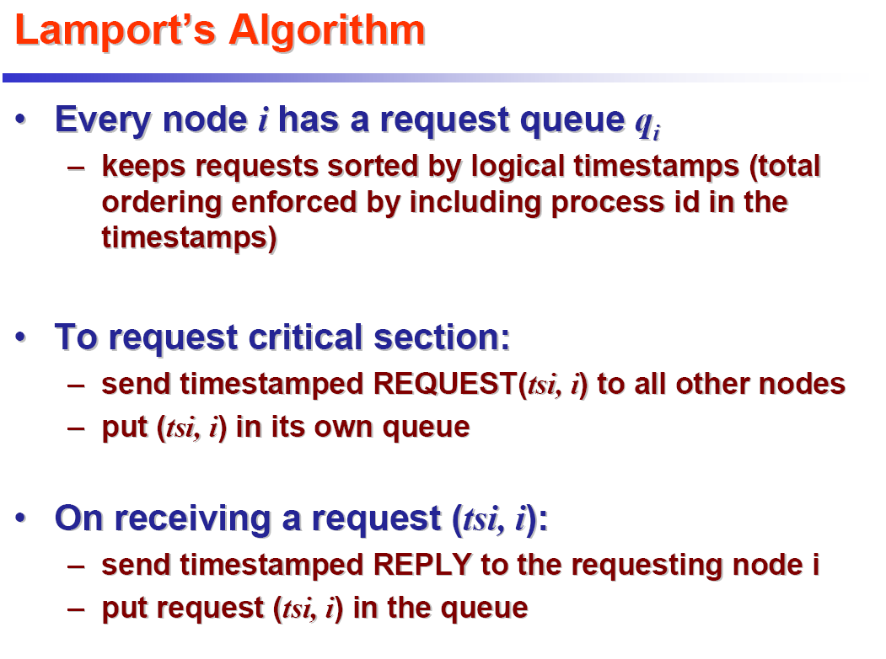
at j
q_{j}
REPLY(tsj, j)

Slide 20
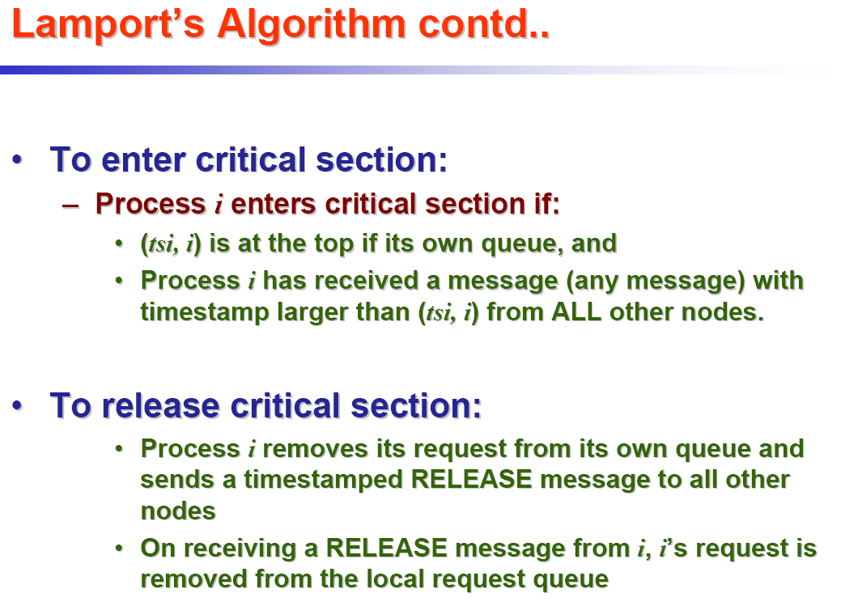

Slide 21
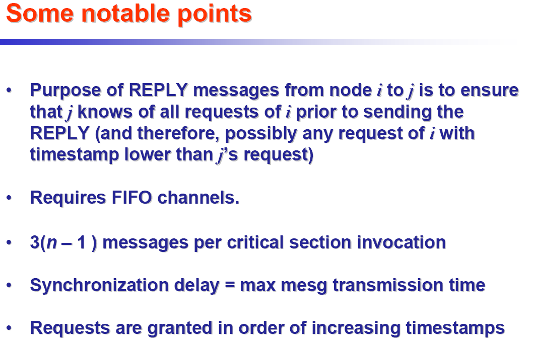

Slide 22
Permission from all (distributed) processes – Distributed Algorithm
Lamport’s Algorithm
Ricart Agarwala Algorithm

Slide 23
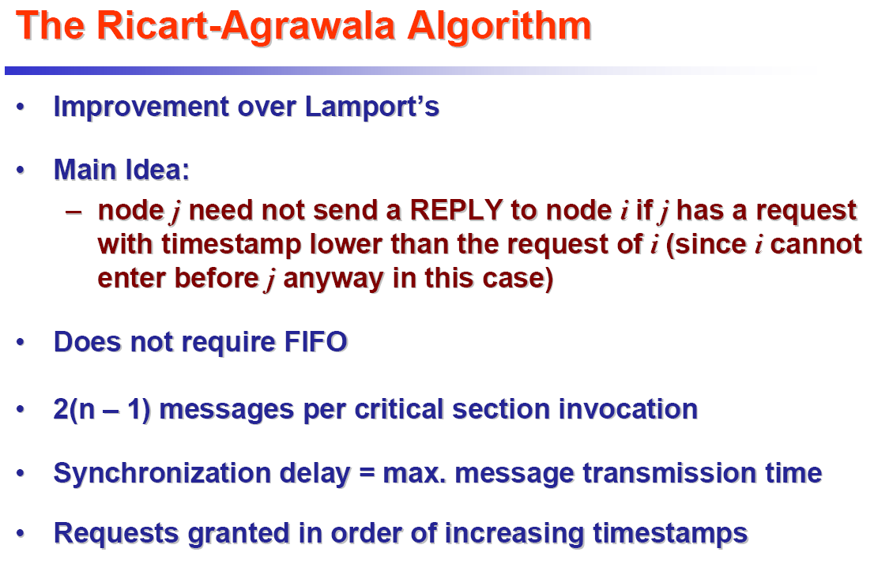

Slide 24
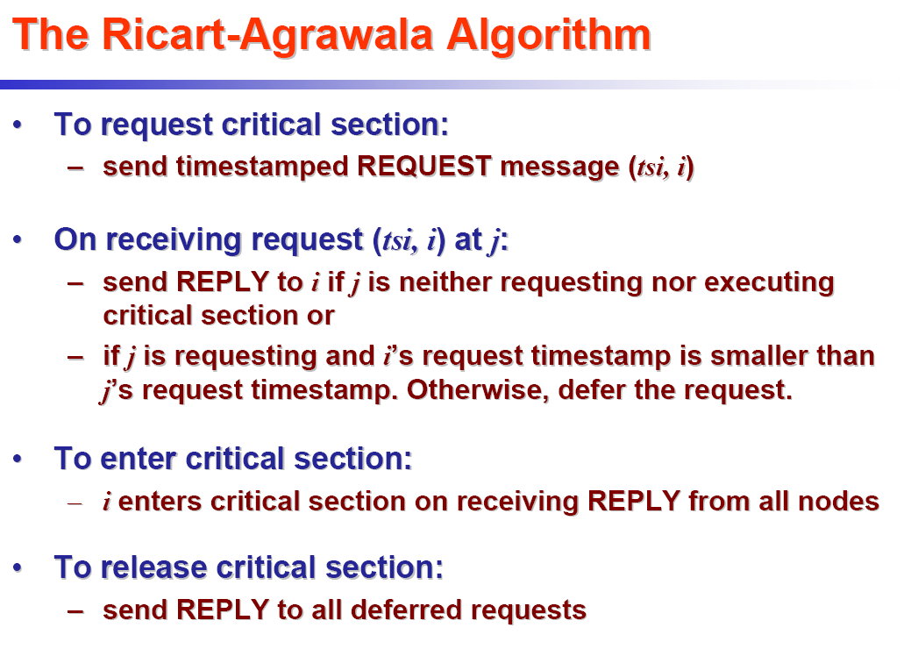

Slide 25
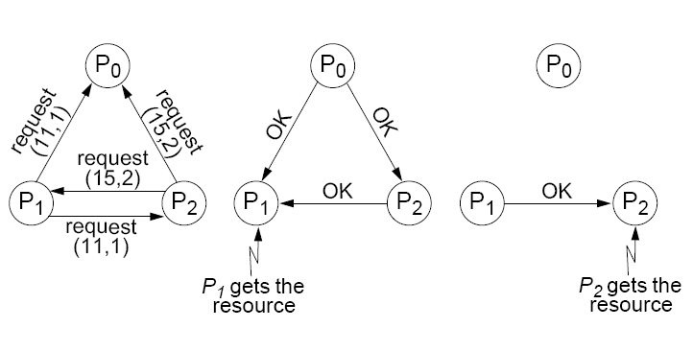
Example:

Slide 26
Mutual Exclusion Algorithms
Non-token based (permission based) Algorithms:
Permission from a central Coordinator
Central Coordinator Based Algorithm
Permission from all (distributed) processes
Lamport Algorithm
Ricart Agarwala Algorithm
Token Based Algorithm
Token Ring Algorithm
Suzuki Kasami Algorithm
Raymond Algorithm
Singhal Algorithm etc.

Slide 27
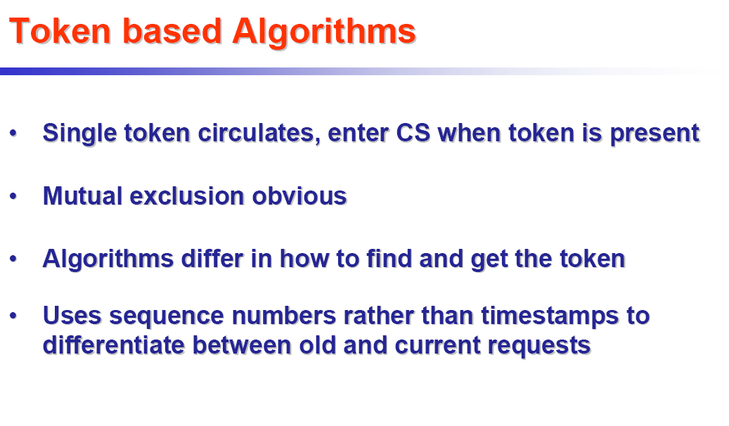

Slide 28
Token Based Algorithms
A token is circulated in a logical ring.
A process enters its CS if it has the token.
Issues:
If the token is lost, it needs to be regenerated.
Detection of the lost token is difficult since there is no bound on how long a process should wait for the token.
If a process can fail, it needs to be detected and then by-passed.
When nobody wants to enter, processes keep on exchanging messages to circulate the token

Slide 29
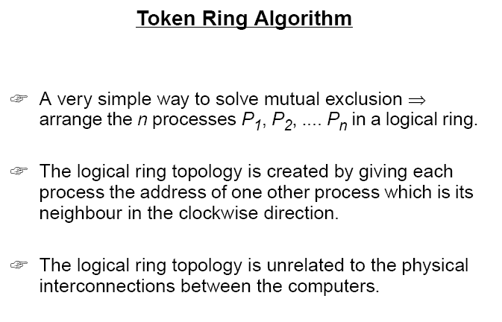

Slide 30
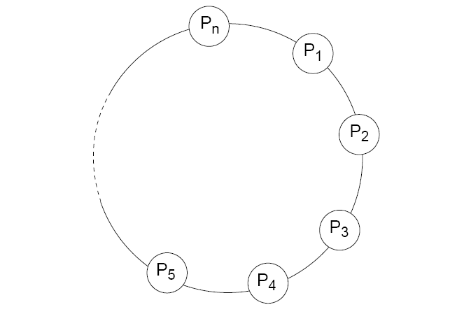
Token Ring Algorithm

Slide 31
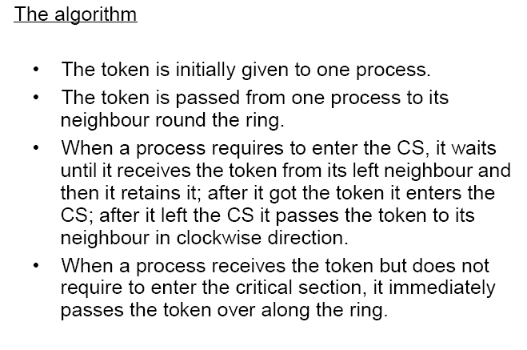
Token Ring Algorithm

Slide 32
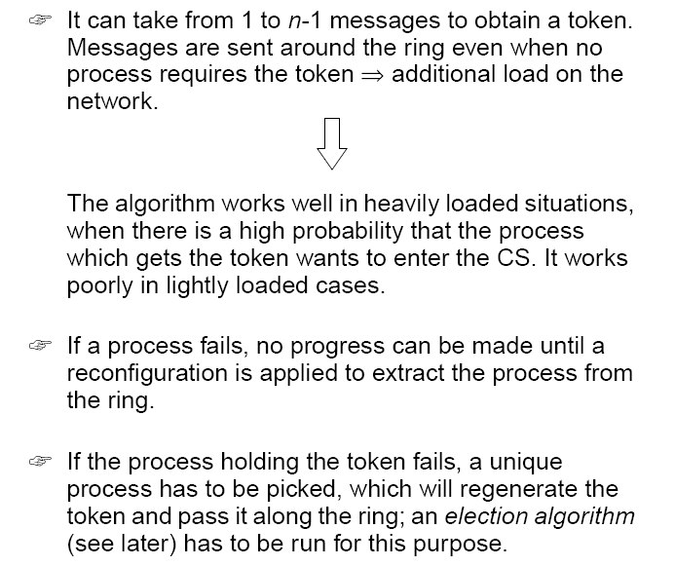
Token Ring Algorithm

Slide 33
Mutual Exclusion Algorithms
Non-token based (permission based) Algorithms:
Permission from a central Coordinator
Central Coordinator Based Algorithm
Permission from all (distributed) processes
Lamport Algorithm
Ricart Agarwala Algorithm
Token Based Algorithm
Token Ring Algorithm
Suzuki Kasami Algorithm
Raymond Algorithm
Singhal Algorithm etc.

Slide 34
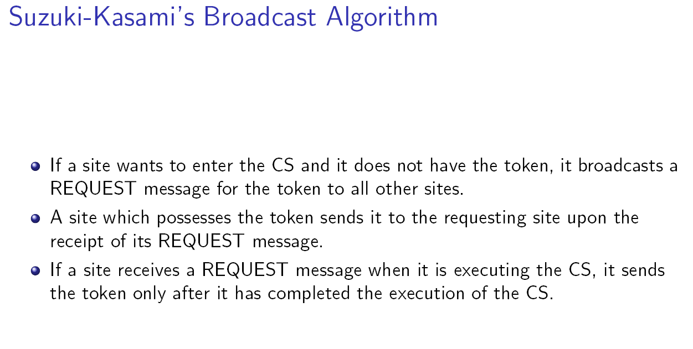
Suzuki Kasami Algorithm

Slide 35
Some Points about the Suzuki Kasami algorithm
Only the site currently holding the token can access the CS
All processes involved in the assignment of the CS
Request messages sent to all nodes
Not based on Lamport’s logical clock
The algorithm uses sequence numbers instead
Used to keep track of outdated requests
They advance independently on each site

Slide 36
Some Points about the Suzuki Kasami algorithm – contd…
The main design issues of the algorithm:
Telling outdated requests from current ones
Determining which site is going to get the token next
Data structures used to deal with these two aspects:
Each site Si has an array RNi[1..N] to store the sequence Number of the latest requests received from other sites
The token contains two data structures:
The token array LN[1..N] keeps track of the request executed most recently on each site
The token queue Q is a queue of requesting sites

Slide 37
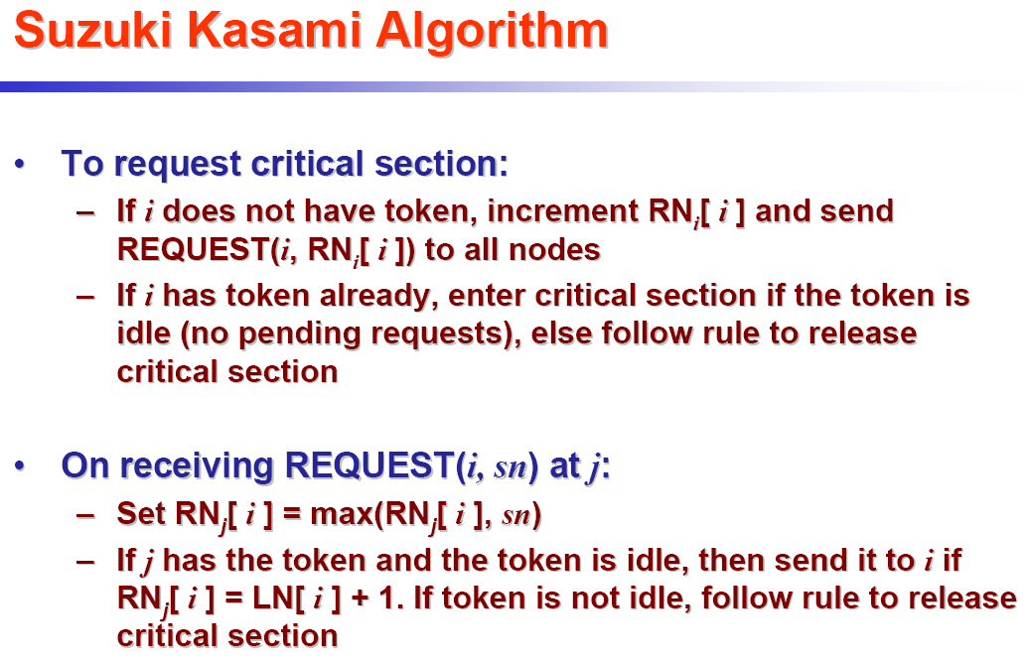

Slide 38
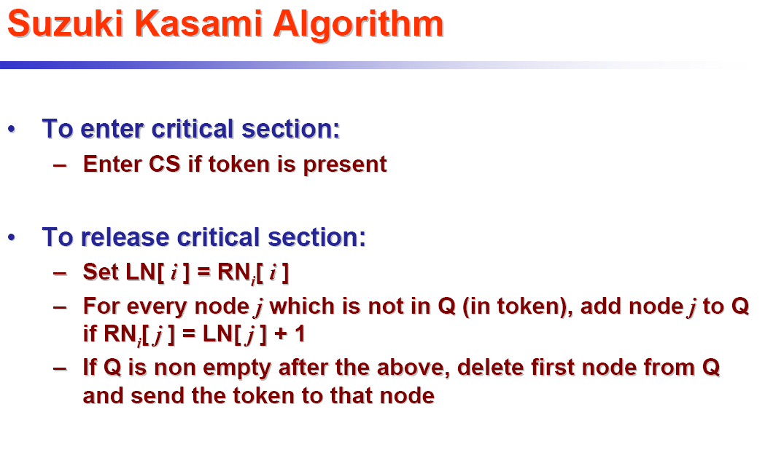

Slide 39
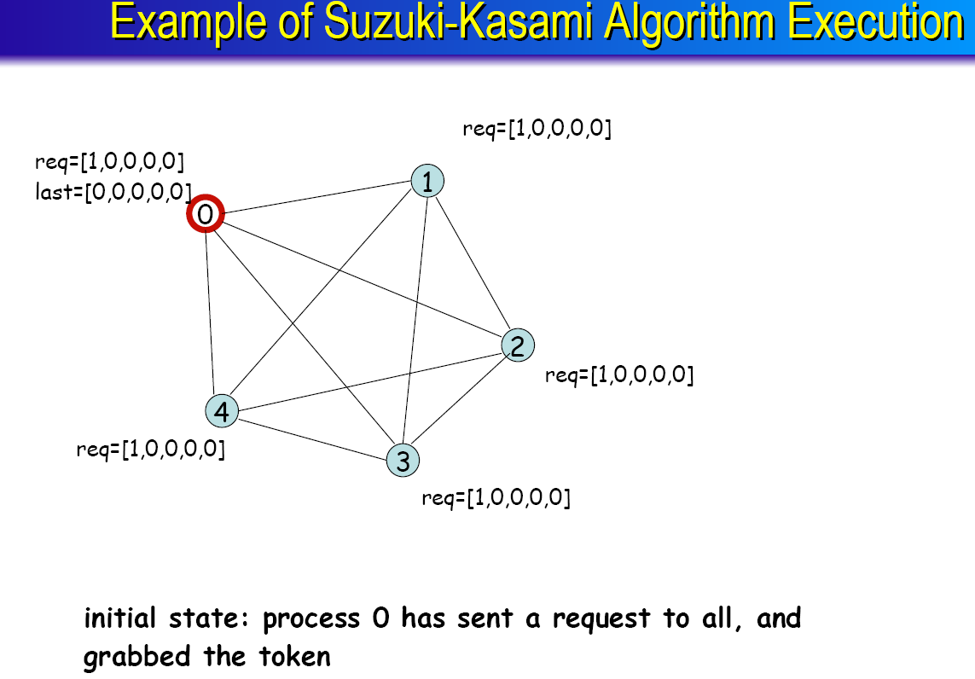

Slide 40
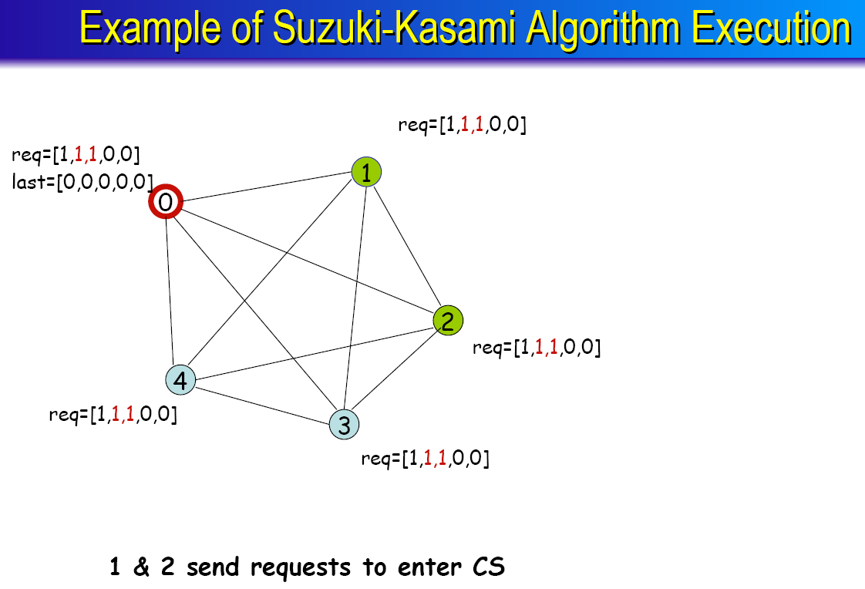

Slide 41
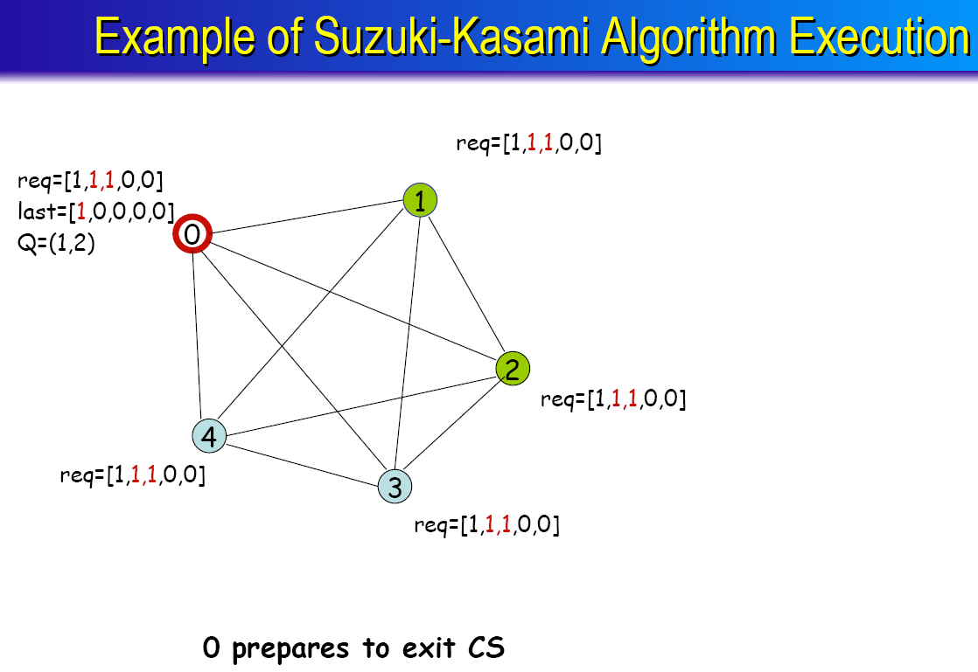

Slide 42
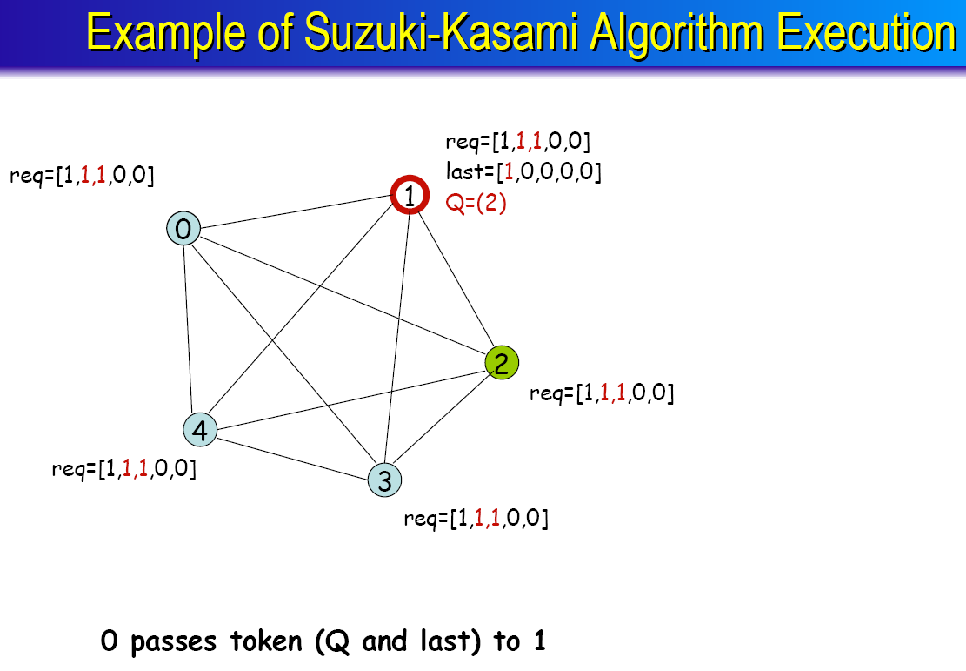

Slide 43
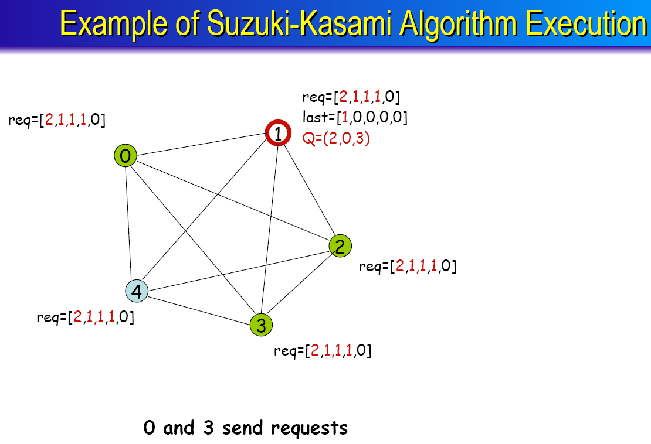

Slide 44
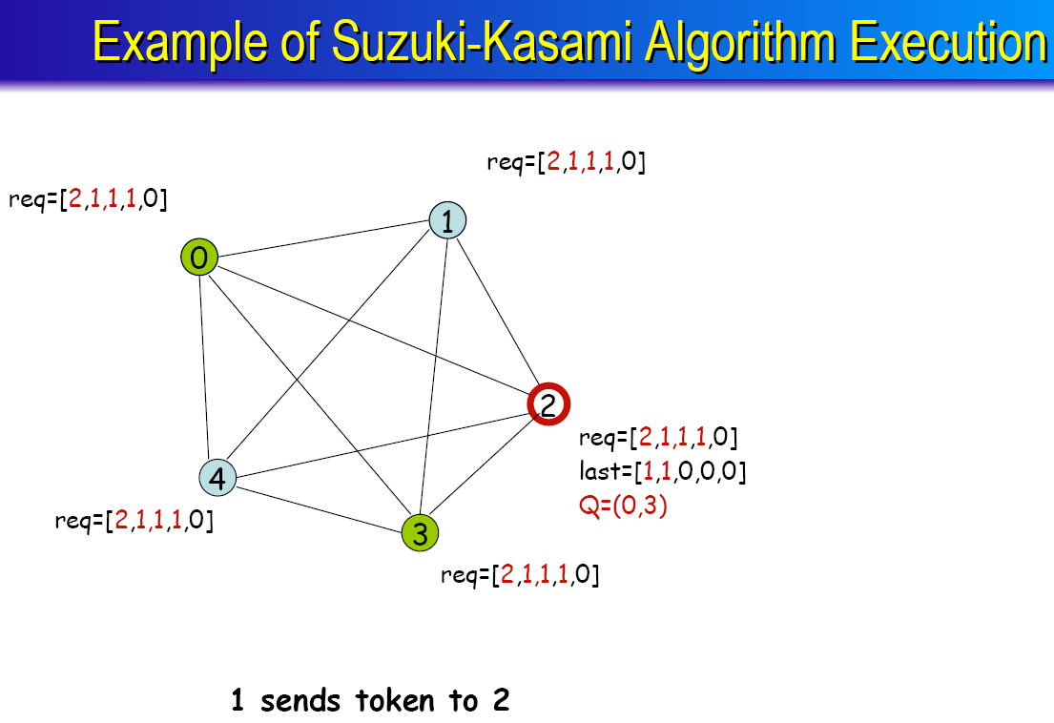

Slide 45
Mutual Exclusion Algorithms
Non-token based (permission based) Algorithms:
Permission from a central Coordinator
Central Coordinator Based Algorithm
Permission from all (distributed) processes
Lamport Algorithm
Ricart Agarwala Algorithm
Token Based Algorithm
Token Ring Algorithm
Suzuki Kasami Algorithm
Raymond Algorithm
Singhal Algorithm etc.

Slide 46
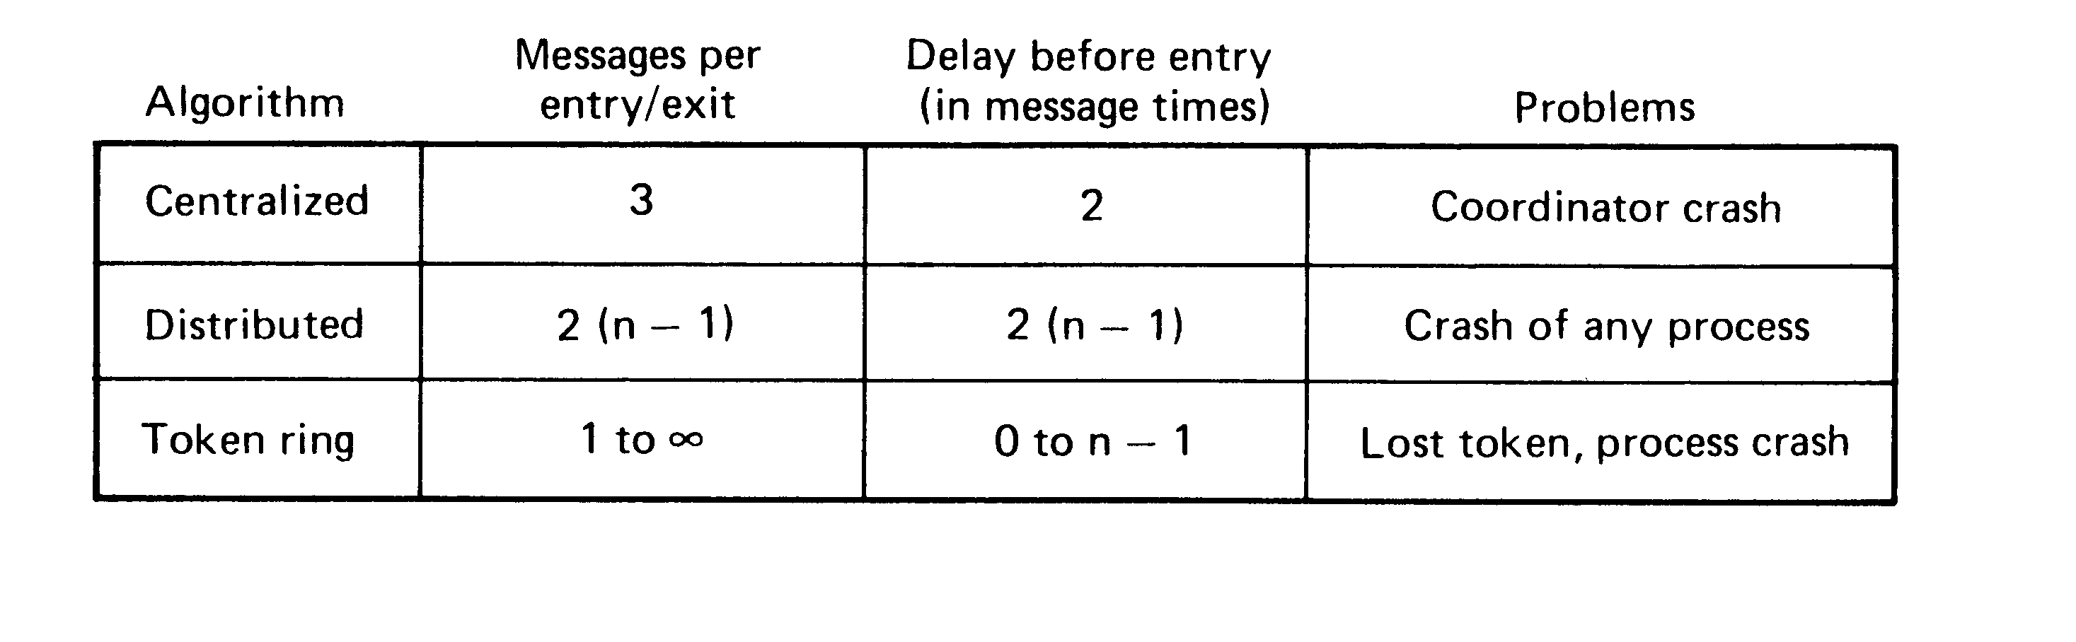
Comparison
A comparison of three mutual exclusion algorithms

Slide 47
Election Algorithm

Slide 48
Election
In distributed computing, leader election is the process of designating a single process as the organizer of some task distributed among several computers (nodes).
Before the task is begun, all network nodes are unaware which node will serve as the "leader," or coordinator, of the task.
After a leader election algorithm has been run, however, each node throughout the network recognizes a particular, unique node as the task leader.

Slide 49
Election Algorithm
Many distributed algorithms require one process to act as a coordinator or, in general, perform some special role, and that coordinator is selected using an Election Algorithm

Slide 50
Need of Election Algorithm: Few Examples
Clock Synchronization
Berkeley Algorithm: To select a leader or master to take the responsibility of averaging the time.
Mutual Exclusion
Central coordinator algorithm: at initialization or whenever the coordinator crashes, a new coordinator has to be elected
Token ring algorithm: when the process holding the token fails, a new process has to be elected which generates the new token
Any Distributed Computing
A distributed algorithm is an algorithm, run on a distributed system, that does not assume the previous existence of a central coordinator.
Need to select a master to take the responsibility of distributing the sub-problems among the slaves and collecting the partial results from them

Slide 51
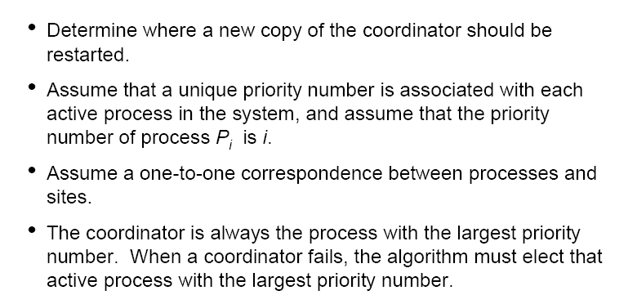
Election Algorithm: Basic Concepts (1)

Slide 52
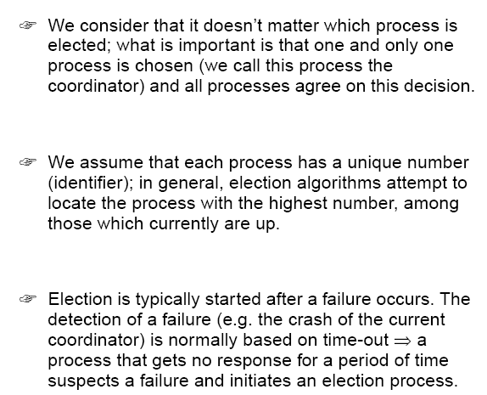
Election Algorithm: Basic Concepts (2)

Slide 53
Phases of Any Election Algorithm
☞ An election process is typically performed in two phases:
Select a leader with the highest priority.
Inform all processes about the winner

Slide 54
Election Algorithms
Here we will discuss the following two basic Election algorithms
Bully Algorithm
Chang and Roberts algorithm (Ring Algorithm)

Slide 55
Bully Algorithm
This algorithm is applicable to elect a leader in a distributed system connected with each other (say in a mesh topology).
The bully algorithm is a method in distributed computing for dynamically selecting a coordinator by process ID number.
Assumptions
The system is synchronous and uses timeout for identifying process failure

Slide 56
Bully Algorithm
Message types
Election Message : Sent to announce the election
Answer Message : Respond to the election message
Coordinator message: sent to announce the identity elected process
Compare with Ring algorithm:
Assumes that system is synchronous
Uses timeout to detect process failure/crash
Each processor knows which processor has the higher identifier number and communicates with that

Slide 57
Bully Algorithm: Basic Steps
When a process P determines that the current coordinator is down because of message timeouts or failure of the coordinator to initiate a handshake, it performs the following sequence of actions:
P broadcasts an election message (inquiry) to all other processes with higher process IDs.
If P hears from no process with a higher process ID than it, it wins the election and broadcasts victory.
If P hears from a process with a higher ID, P waits a certain amount of time for that process to broadcast itself as the leader. If it does not receive this message in time, it re-broadcasts the election message.
If P gets an election message (inquiry) from another process with a lower ID it sends an "I am alive" message back and starts new elections.
Note that if P receives a victory message from a process with a lower ID number, it immediately initiates a new election. This is how the algorithm gets its name - a process with a higher ID number will bully a lower ID process out of the coordinator position as soon as it comes online.

Slide 58
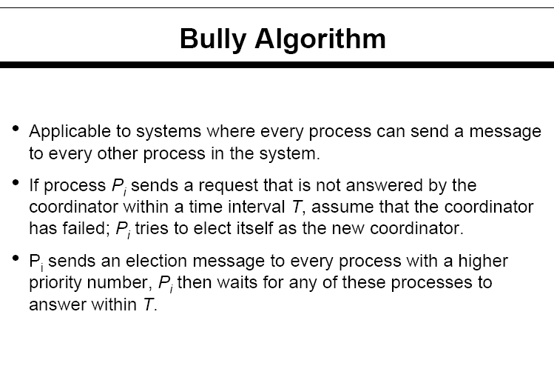
Bully Algorithm: Detailed Algorithm

Slide 59
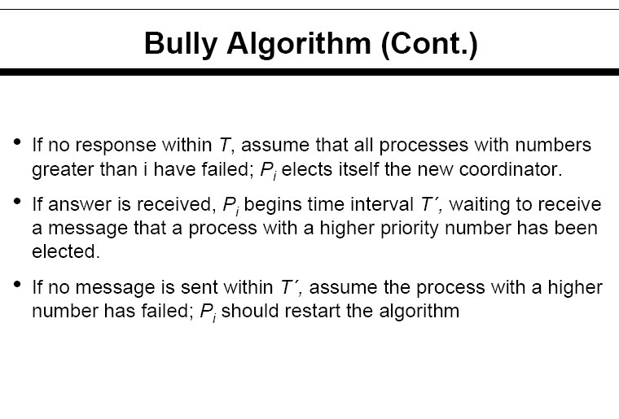

Slide 60
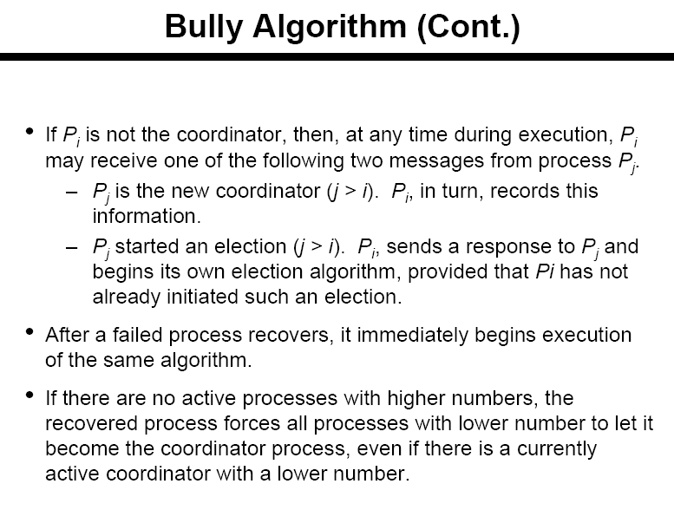

Slide 61
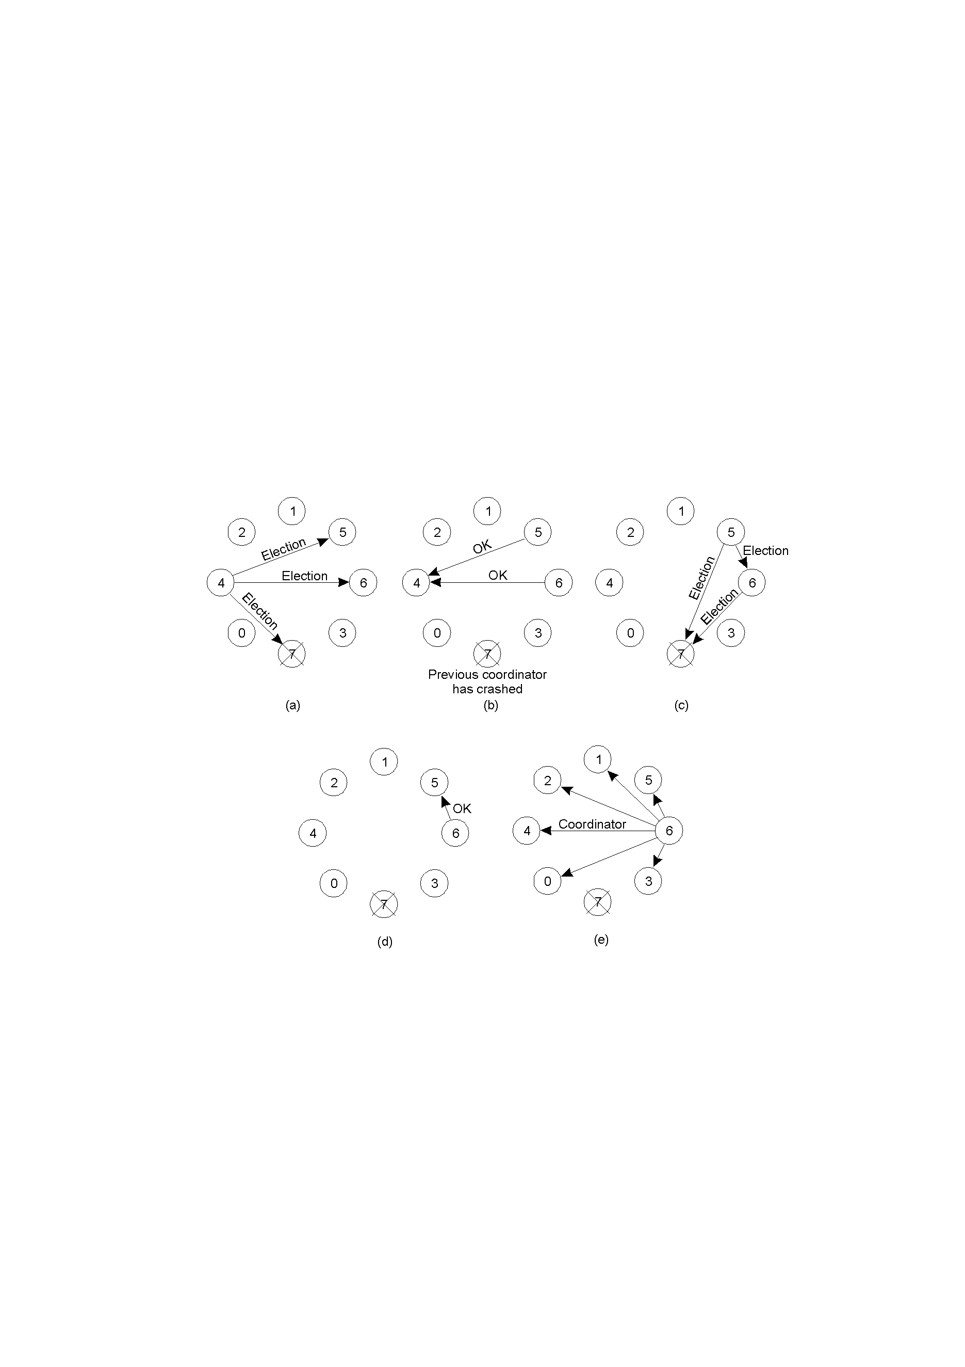
Bully Algorithm: Example (1)
Process 4 holds an election
Process 5 and 6 respond, telling 4 to stop
Now 5 and 6 each hold an election

Slide 62
Bully Algorithm: Example (2)
Process 6 tells 5 to stop
Process 6 wins and tells everyone

Slide 63
Election Algorithms
Here we will discuss the following two basic Election algorithms
Bully Algorithm
Chang and Roberts algorithm (Ring Algorithm)

Slide 64
Chang and Roberts algorithm
Chang and Roberts is a ring-based election algorithm used to find a process with the largest identification.
It is a useful method of election in decentralized distributed computing where the systems are connected in a logical or physical ring.
The algorithm works for any number of processes N, and does not require any process to know how many processes are in the ring.
Is often referred as a ring algorithm.

Slide 65
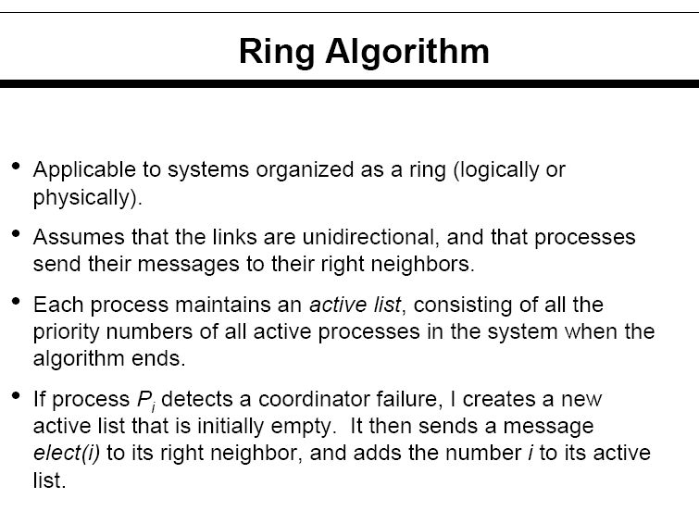
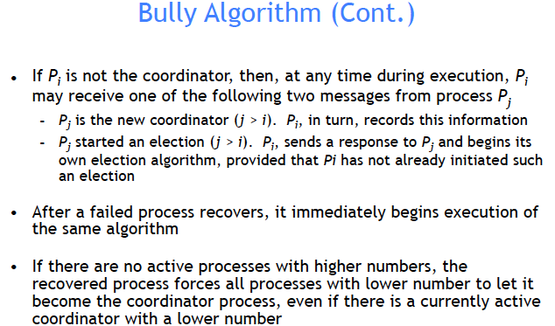
P_{i}

Slide 66
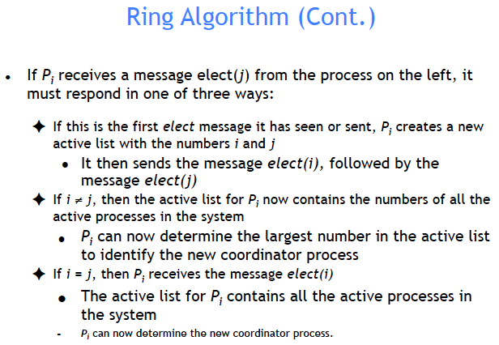

Slide 67
Ring Algorithm: Example1
Suppose that we have four processes arranged in a ring: P1 , P2 , P3 , P4 , P1 …
P4 is coordinator
Suppose P1 + P4 crash
Suppose P2 detects that coordinator P4 is not responding
P2 sets active list to [ ]
P2 sends “Elect(2)” message to P3; P2 sets active list to [2]
P3 receives “Elect(2)”
This message is the first message seen, i.e., P3 is not yet a participant, so P3 sets its active list to [2,3]
P3 sends “Elect(3)” towards P4 and then sends “Elect(2)” towards P4
The messages pass P4 + P1 and then reach P2
P2 adds 3 to active list [2,3]
P2 forwards “Elect(3)” to P3
P2 receives the “Elect(2) message
P2 chooses P3 as the highest process in its list [2, 3] and sends an “Elected(P3)” message P3 receives the “Elect(3)” message
P3 chooses P3 as the highest process in its list [2, 3] + sends an “Elected(P3)” message

Slide 68
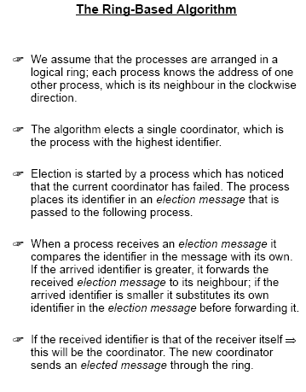

Slide 69
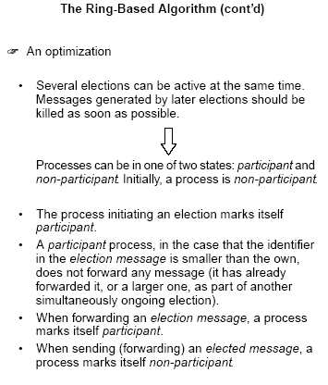

Slide 70
Algorithm
Initially each process in the ring is marked as non-participant.
A process that notices a lack of leader starts an election. It creates an election message containing its UID. It then sends this message clockwise to its neighbor.
Every time a process sends or forwards an election message, the process also marks itself as a participant.
When a process receives an election message it compares the UID in the message with its own UID.
If the UID in the election message is larger, the process unconditionally forwards the election message in a clockwise direction.
If the UID in the election message is smaller, and the process is not yet a participant, the process replaces the UID in the message with its own UID, sends the updated election message in a clockwise direction.
If the UID in the election message is smaller, and the process is already a participant (i.e., the process has already sent out an election message with a UID at least as large as its own UID), the process discards the election message.
If the UID in the incoming election message is the same as the UID of the process, that process starts acting as the leader.

Slide 71
Algorithm (contd..)
When a process starts acting as the leader, it begins the second stage of the algorithm.
The leader process marks itself as non-participant and sends an elected message to its neighbor announcing its election and UID.
When a process receives an elected message, it marks itself as non-participant, records the elected UID, and forwards the elected message unchanged.
When the elected message reaches the newly elected leader, the leader discards that message, and the election is over.

Slide 72
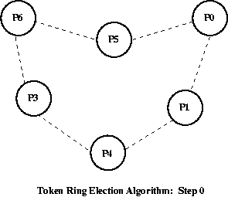
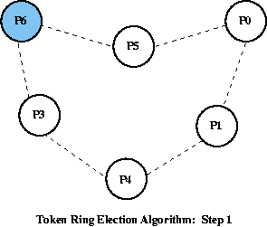
We start with 6 processes, connected in a logical ring. Process 6 is the leader, as it has the highest number.
Process 6 fails

Slide 73
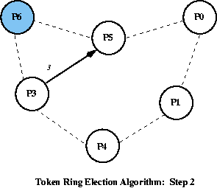
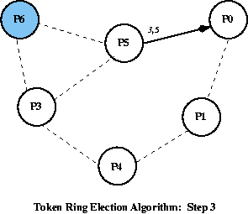
Process 3 notices that Process 6 does not respond So it starts an election, sending a message containing its id to the next node in the ring.
Process 5 passes the message on, adding its own id to the message.

Slide 74
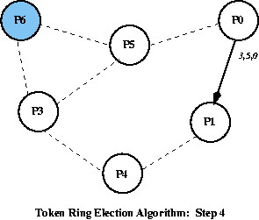
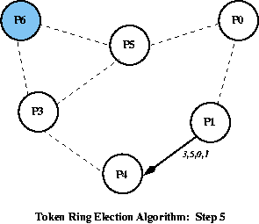
Process 0 passes the message on, adding its own id to the message.
Process 1 passes the message on, adding its own id to the message.

Slide 75
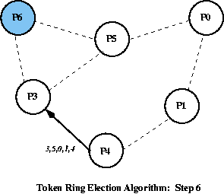
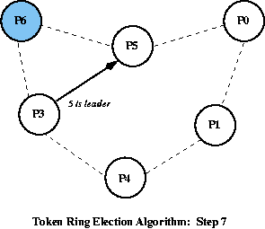
Process 4 passes the message on, adding its own id to the message.
When Process 3 receives the message back, it knows the message has gone around the ring, as its own id is in the list.Picking the highest id in the list, it starts the coordinator message "5 is the leader" around the ring.

Slide 76
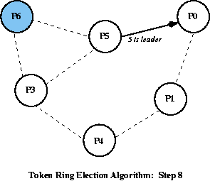
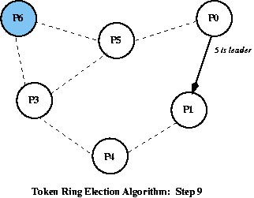
Process 5 passes on the coordinator message.
Process 0 passes on the coordinator message.

Slide 77
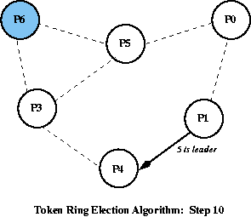
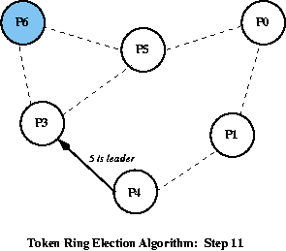
Process 3 receives the coordinator message, and stops it.
Process 1 passes on the coordinator message.

